Slide 1
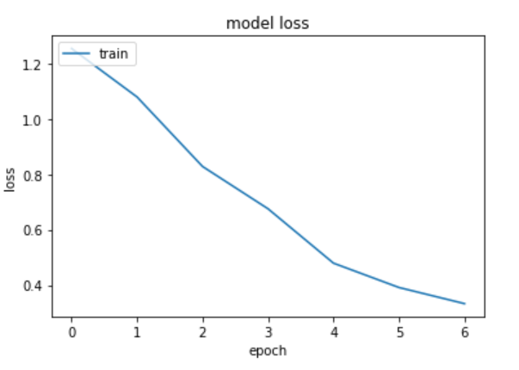
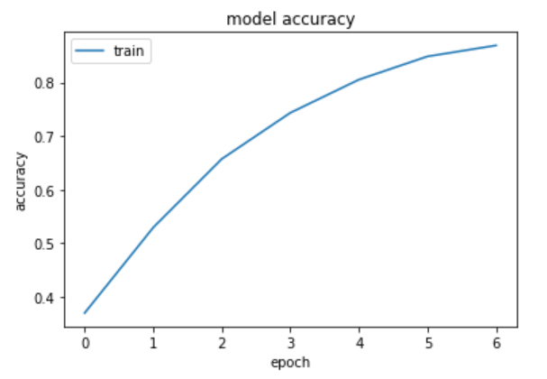
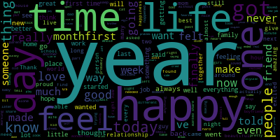
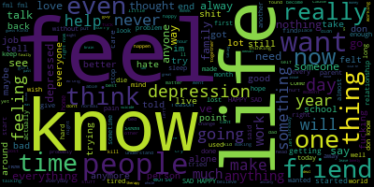
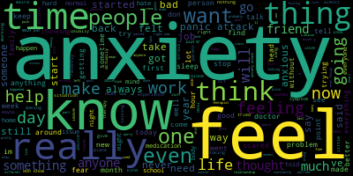
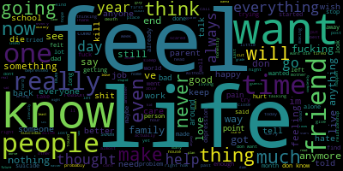
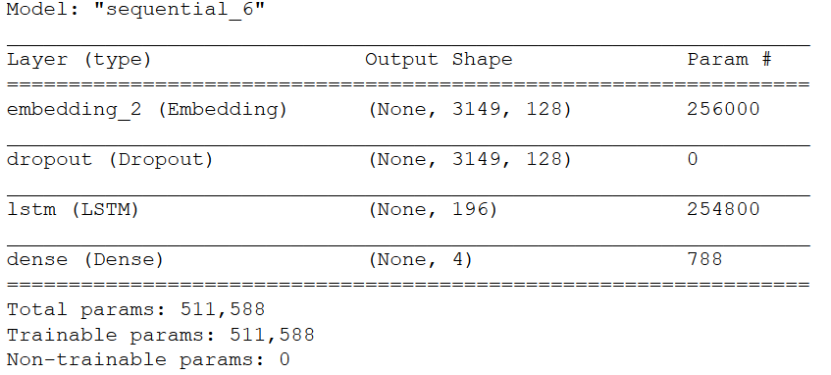

Mental Wellness Sentiment Analysis
Jiaan Nie, 200327281
SUMMARY
RESULTS
The purpose of the project is to attempt to prescreen prospective clients for mental wellness issues by analyzing text. The mental wellbeing of a person is assessed through input of their text using a technique call RNN (Recurrent Neural Network). The initial plan is to create a small prototype that will work on 2 or 3 categories such as depression, anxiety and suicidal thoughts using labeled data that is scraped off from websites and organized using panda, then implement a basic RNN model using Tensorflow and test the result.
REQUIREMENTS
Word Clouds for the Four Different Categories
Hardware Requirements:
i7 CPU
GTX 1080 GPU
Software Requirement :
Anaconda
Tensorflow
Panda
PRAW
WordCloud
METHODOLOGY
Model Summary
First scrape labeled data from reddit, use python to label the data and organize and visualize with panda.
Split the data set into:
2/3 training
1/3 validation
Finally feed training data into the RNN (LSTM) model and use the validation data set to access accuract.
Model Validation Accuracy
IMPROVEMENTS
Tuning Hyper Parameters to improve accuracy.
Data Sanitization such as fix spelling, remove special characters , emoji etc.
More labeled data and better quality data
Testing on different activation functions
CONCLUSION
Overall the accuracy of the model is not ideal, but may still be high enough to be useful when analyzed by a therapist. To improve the model will require better and more labeled data, and to sanitize the data before feeding into the model reduce noise. The model itself seems to be having trouble classifying between depression and suicidal posts due the similarity of contents. Improving these data sets may aid in classification.

